Slide 1
Forecast energy usage of households
CT/DT Number: DT20184336603
Contestant Name: Ayush Agarwal

Slide 2
Table of content
Objective
Problem statement
Analysis
Solution Approach
Result and outcomes
Conclusion

Slide 3
Introduction
The objective is to Forecast energy usage of households,That is to forecast the electricity consumption of top 3 households with highest number of samples on an hourly basis based on the previous usage pattern.
There is a csv file named Power-Networks-LCL.csv that contains the electricity consumption of households on an timely manner .
The category of the problem is time series analysis. Time series analysis is a way to analyse time series(Time series is a series of data points taken in the timely order) and predict or provide the statics, Our goal here is to forecast consumption of electricity of each household and determine the top households on hourly basis.

Slide 4
Objective
01
Analysis of the input dataset
02
Describe the solution approach and model used
03
Results and outcomes

Slide 5
Problem statement
Forecast energy usage of households. - Forecast the electricity consumption of top 3 households with highest number of samples on an hourly basis based on the previous usage pattern. The major features for analysis includes household id, the plans used (standard or dynamic time of use), date, time, meter readings in Kwh.
The csv(Power-Networks-LCL.csv) file contains the data of the year 2012, 2013 and 2014 consisting of entry of electricity consumption of the household every half hour.

Slide 6
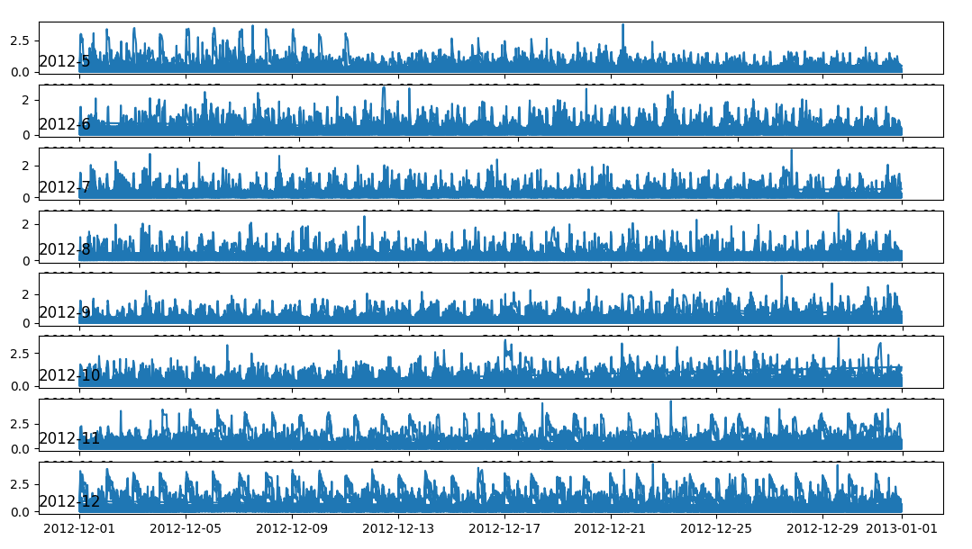
Analysis [Monthly Kwh power consumption]

Slide 7
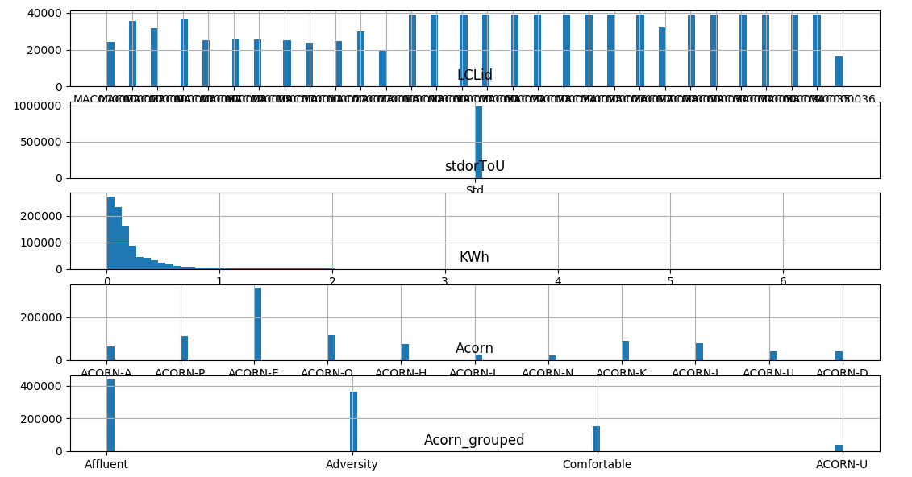
Analysis [Analysis of DataSet]

Slide 8
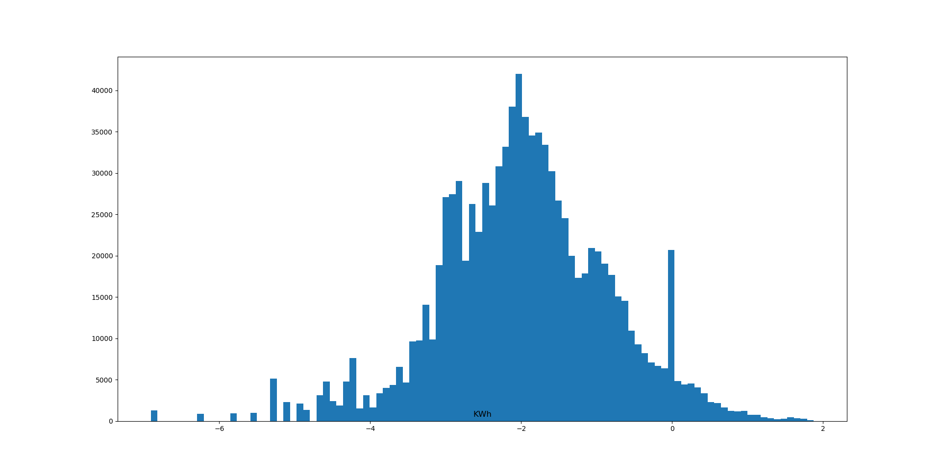
Analysis [KWh after taking log]

Slide 9
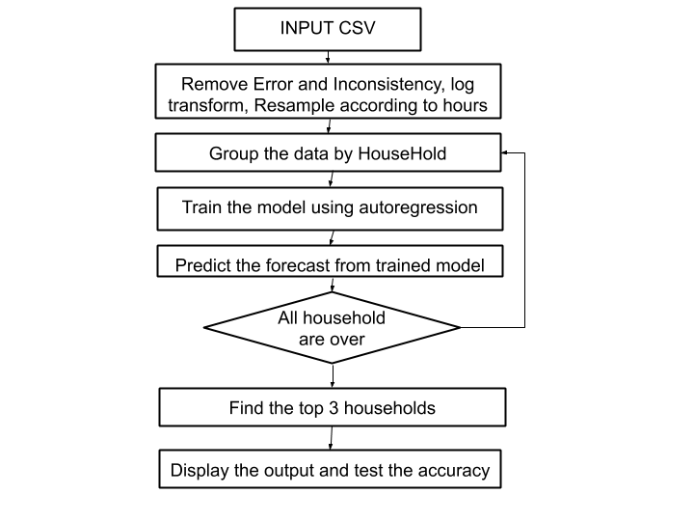
Solution approach

Slide 10
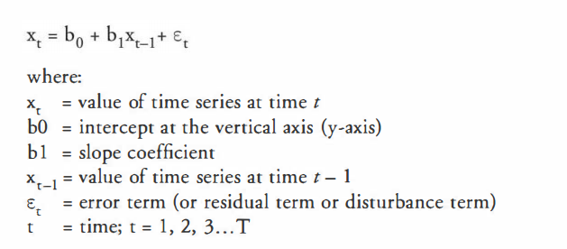
Auto Regression
Autoregression is a time series model that uses observations from previous time steps as input to a regression equation to predict the value at the next time step.

Slide 11
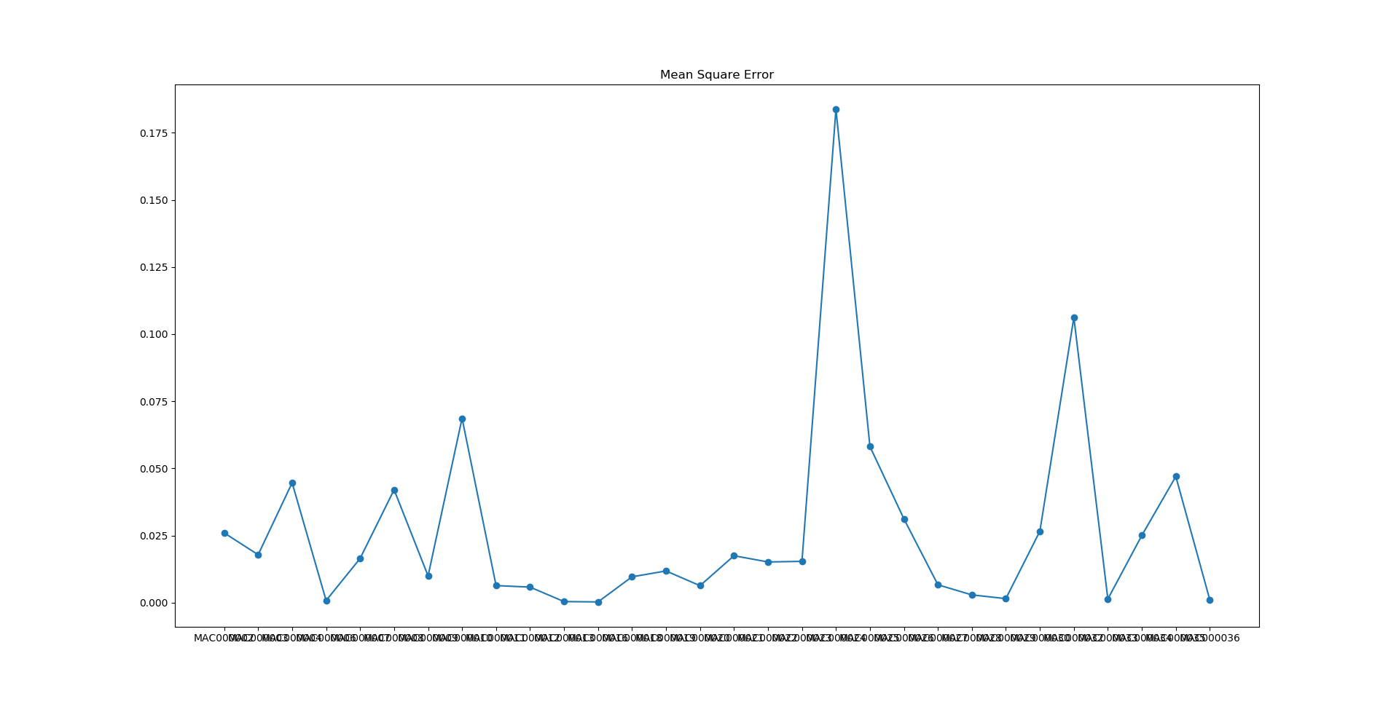
Accuracy

Slide 12
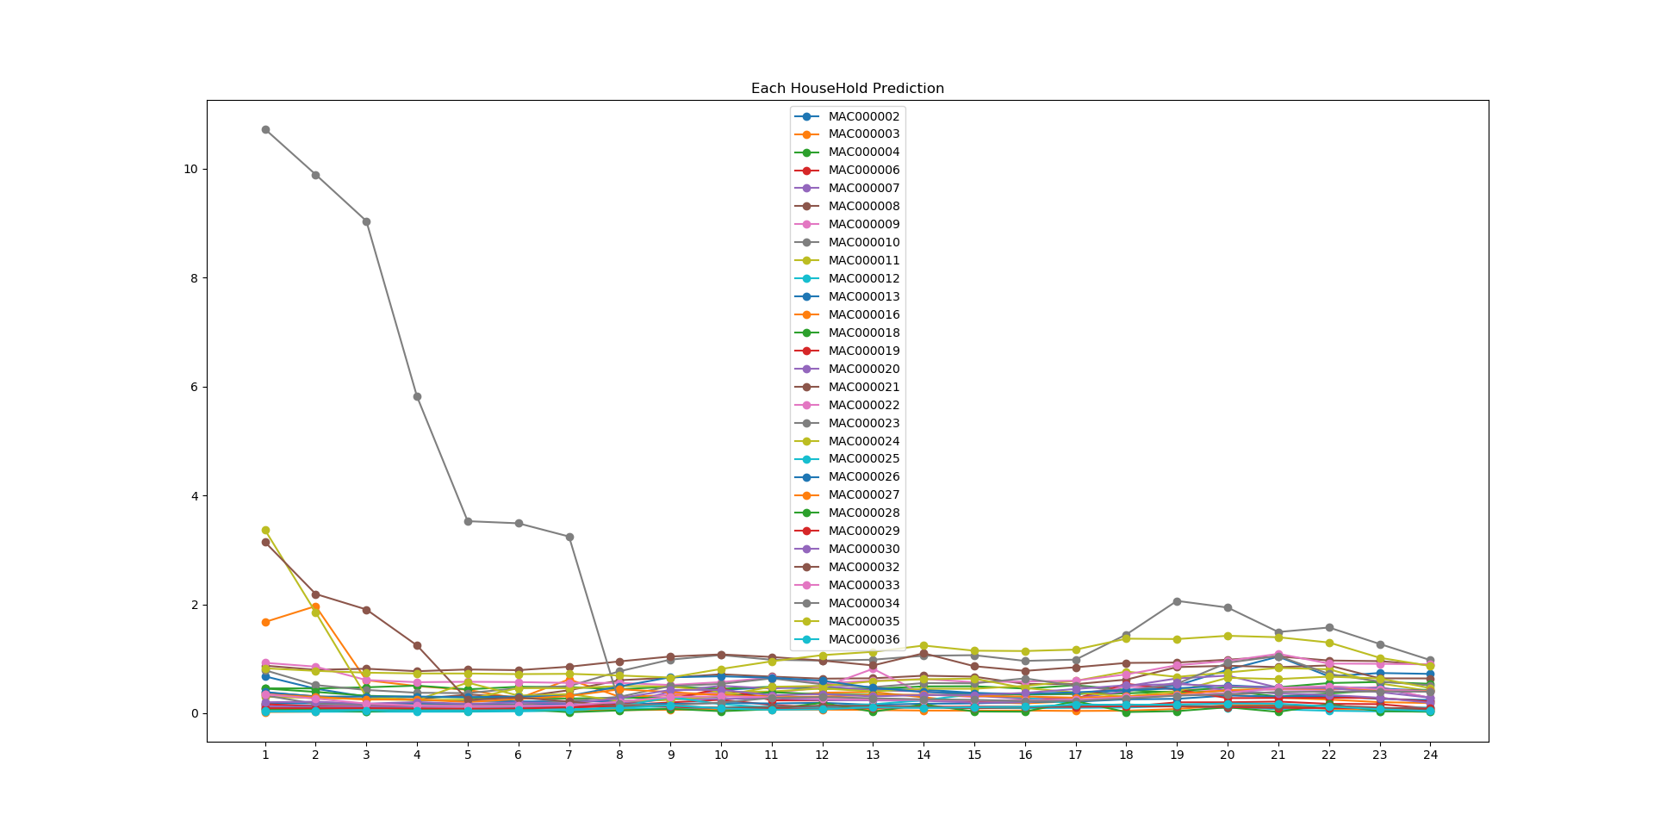
Prediction

Slide 13
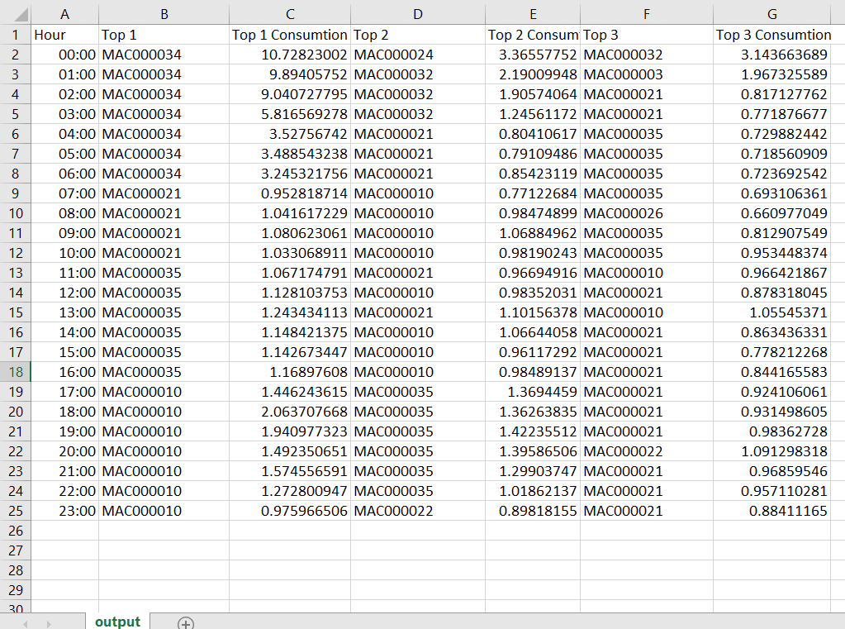
Output

Slide 14
Thankyou

